Slide 1
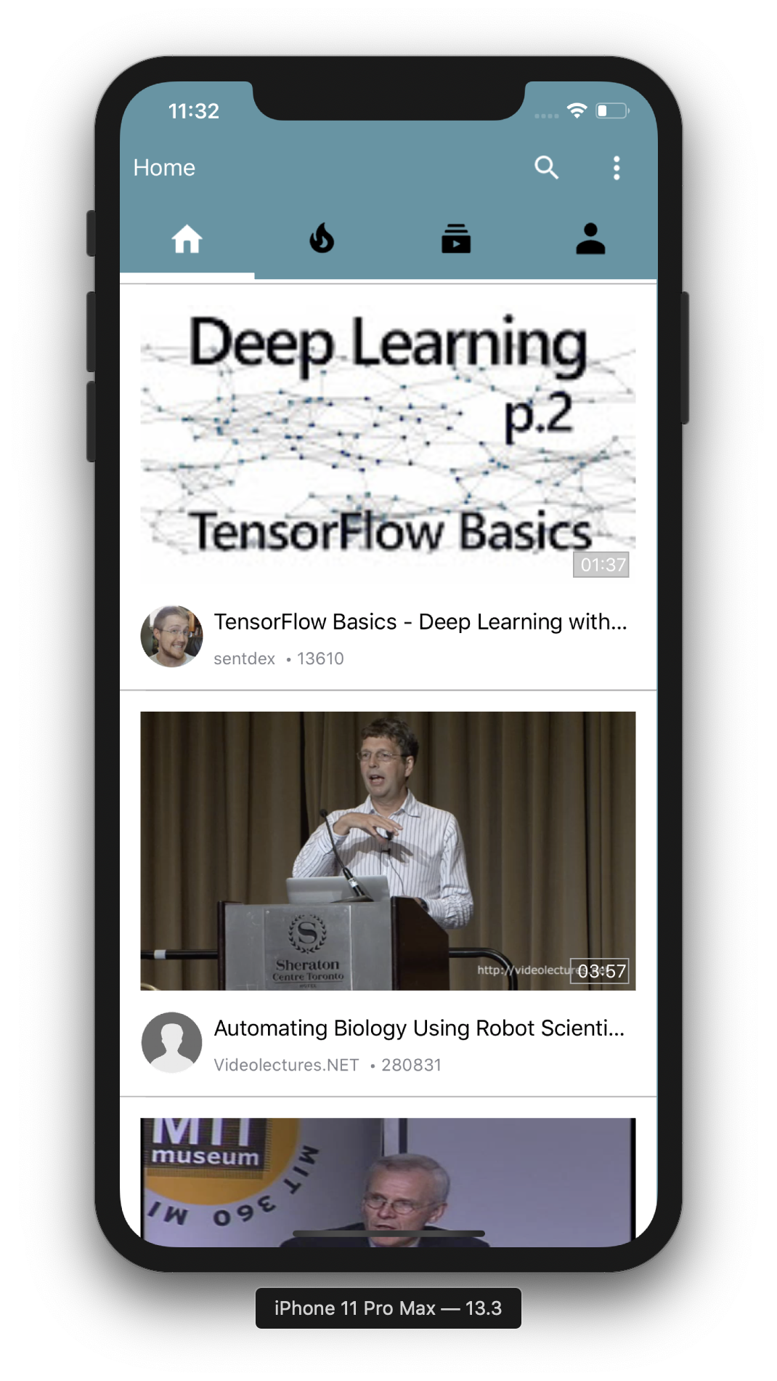

Team 4 : Patrick Wu, Yinrui Hu

Slide 2
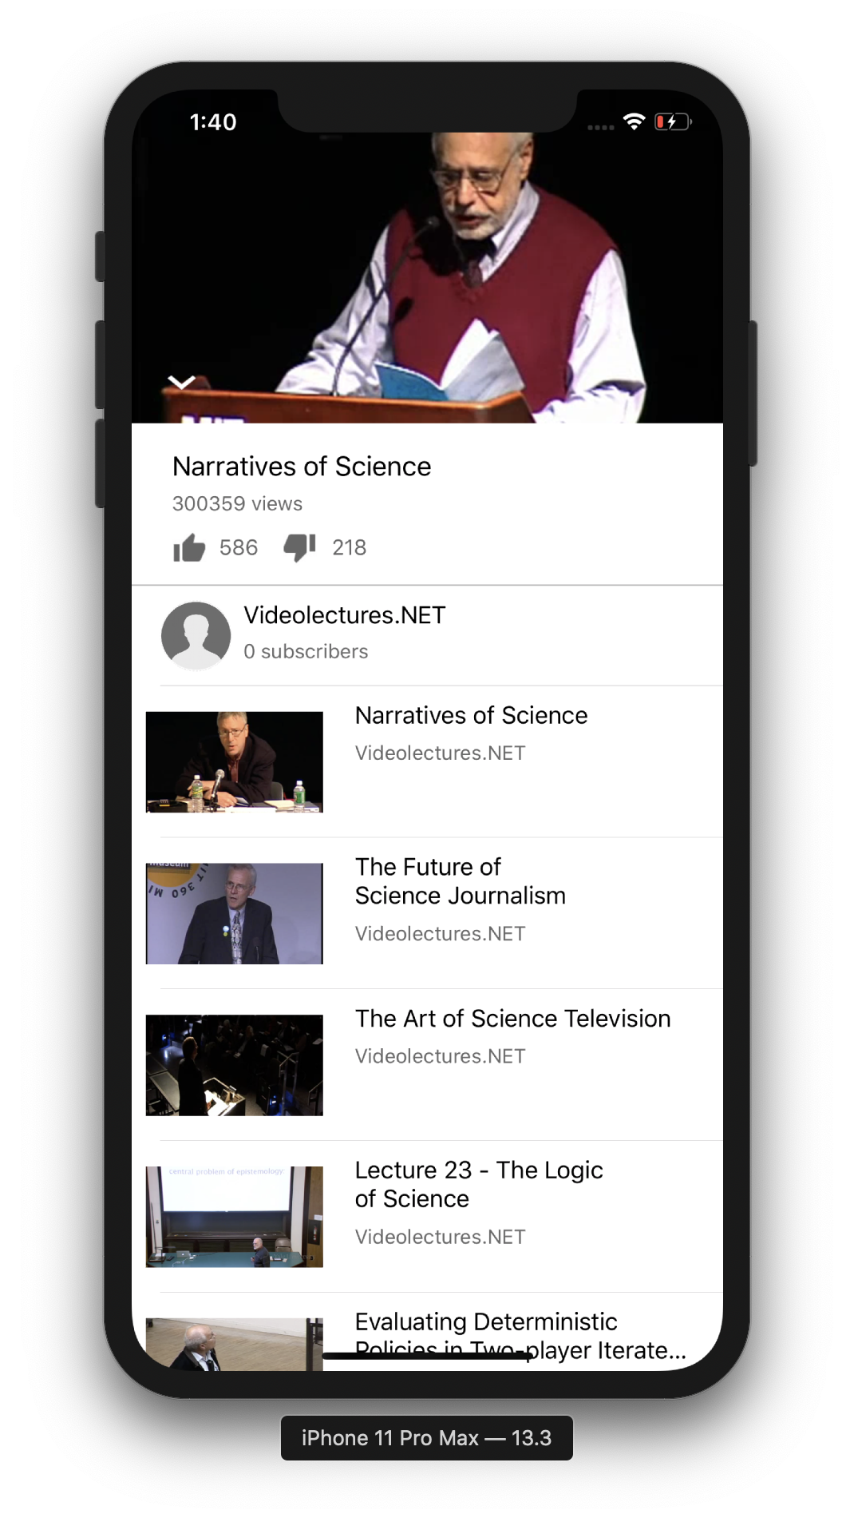
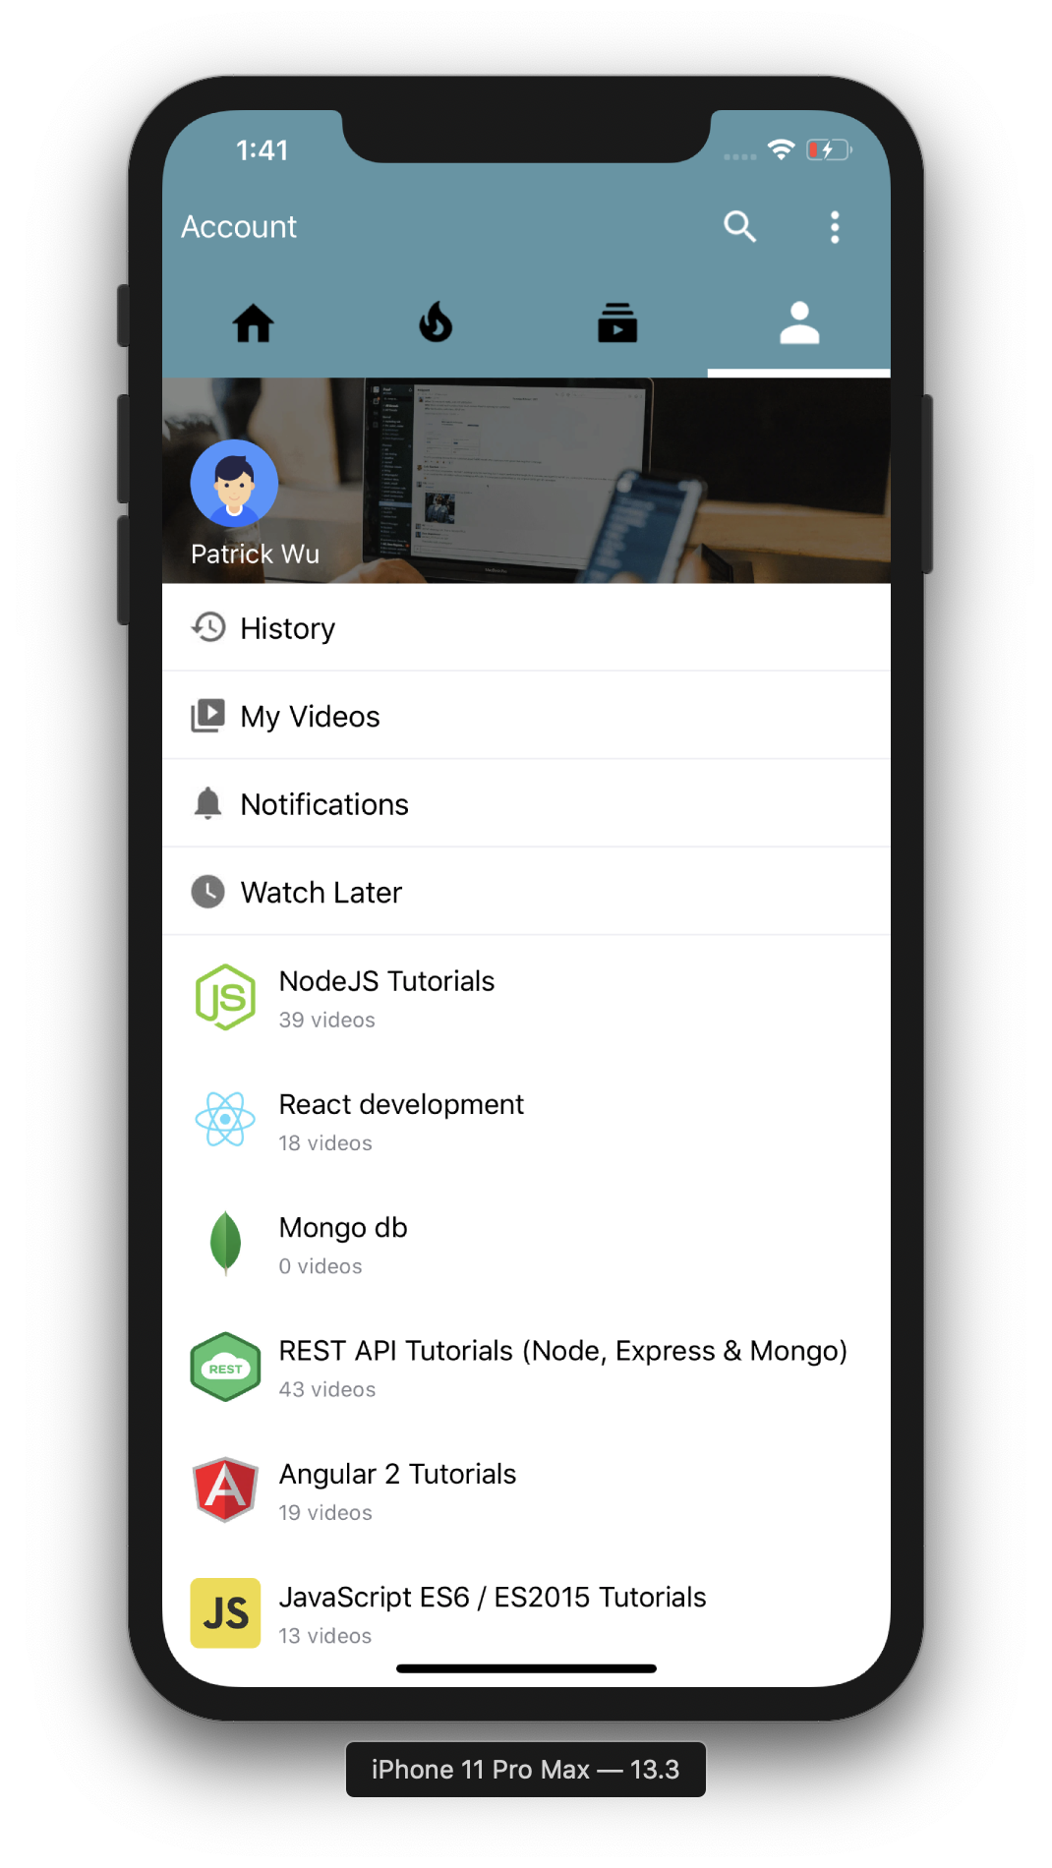
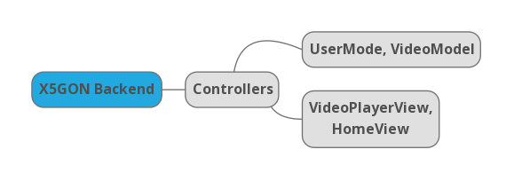
Currently …
Task & Key Requirements
Research & Architecture
a Mobile Application that
provides users with :
an authentic and mobile-friendly X5GON experience
learning materials catered for their needs
provides X5GON with :
Anonymous user data that improves its ML backend
We researched our users by interviewing and made personas accordingly
We designed our software architecture with MVC Model

Slide 3
Looking ahead …
Search and filter functionalities
User Authentication
Integration Testing
Collect user data to personalise materials
Before 30/01
Before 29/02
Before 14/02
Before 09/03
Support PDF and Audio material
Likes and Dislikes
Usability tests
Full-screen mode for videos
Note-taking on learning material

